Slide 1
Space Cleaner
SEUNGHYUN KIM & TAEHYUN YANG

Slide 2
TABLE OF CONTENTS
Game Description
Code Explanation
Video of Playing the Game
Original Code Source

Slide 3
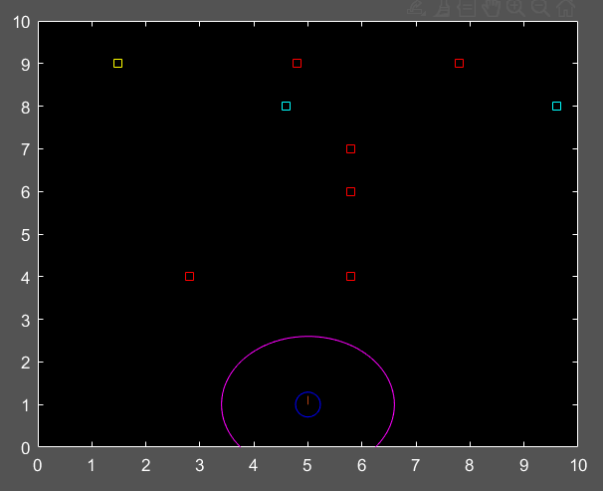
Game Description
This is a game where you shoot down all the space debris with missiles. When you clear the game, the total number of missiles used is displayed.
(how to control)
(1) q: quit the game
(2) ←,→: adjust the angle
(3) ↑,↓: adjust the velocity
(4) Space bar: launch

Slide 4

2. Code Explanation
(1) Space debris generation code
Generates the coordinates of debris by a 10x2 matrix!
-10: The number of pieces of debris
-2: The number of coordinate components (x component and y component)

Slide 5
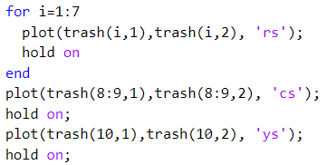

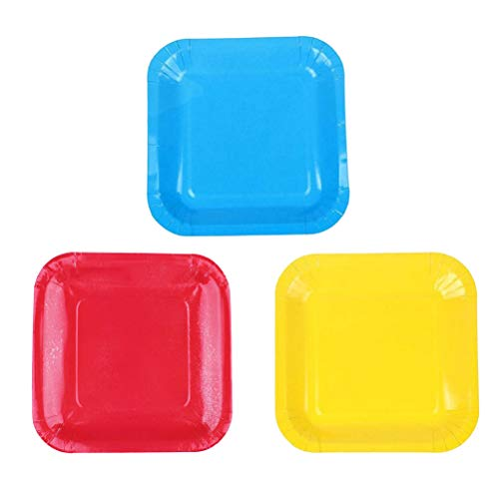
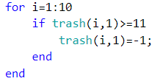
Display debris moving at a constant speed on the screen!
Debris 1 to 7: Red (ordinary)
Debris 8 to 9: Blue
Debris 10: Yellow

Slide 6
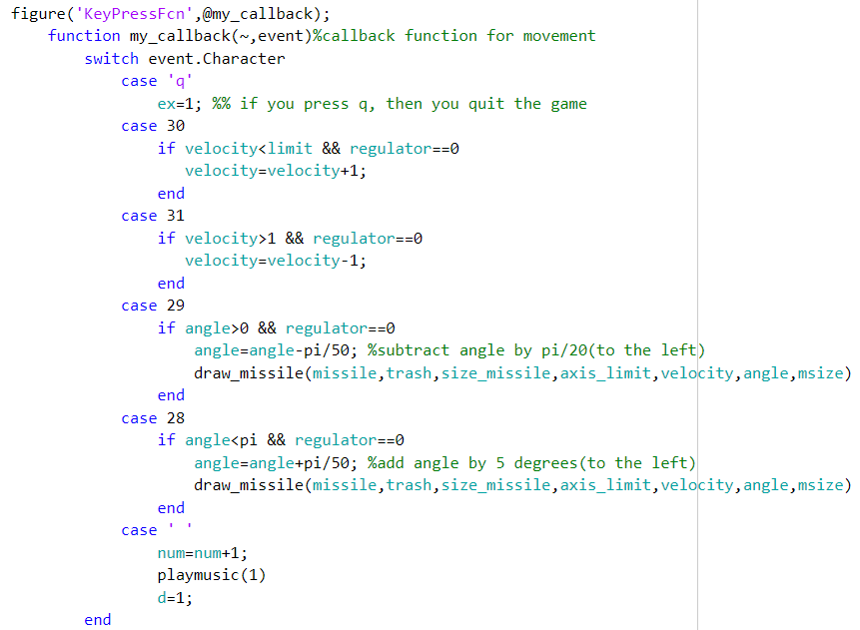
(2) Function of Keyboard Input
This code performs different functions based on the input key by implementing a switch-case statement in the 'KeypressFcn' function.

Slide 7
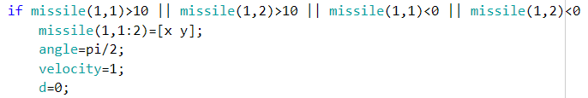
(3) Launching the missile
Missiles move based on the speed and angle values entered through the keyboard.
If a missile goes off the screen, it is considered used, and the player can fire a new missile.

Slide 8
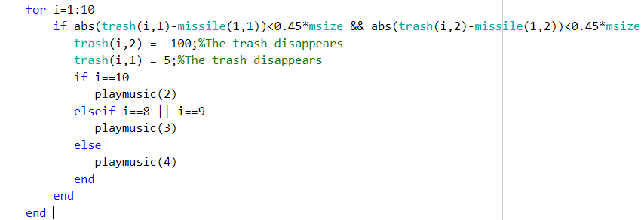
When the distance between the missile and the debris is below a certain distance, it is considered a hit, and the debris disappears from the screen.

Slide 9
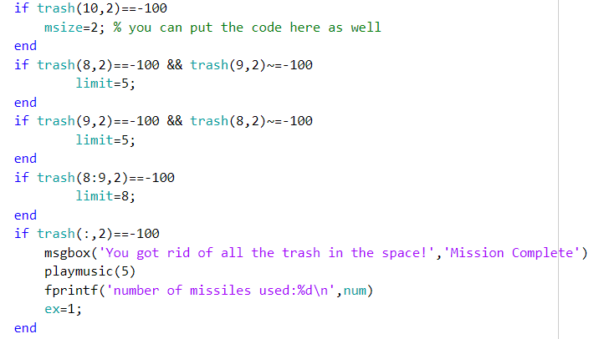


This is a code that implements effects based on which debris you hit: Hitting yellow debris increases the size of the missile, hitting blue debris increases the maximum speed limit of the missile, and hitting all debris ends the game (victory).

Slide 10
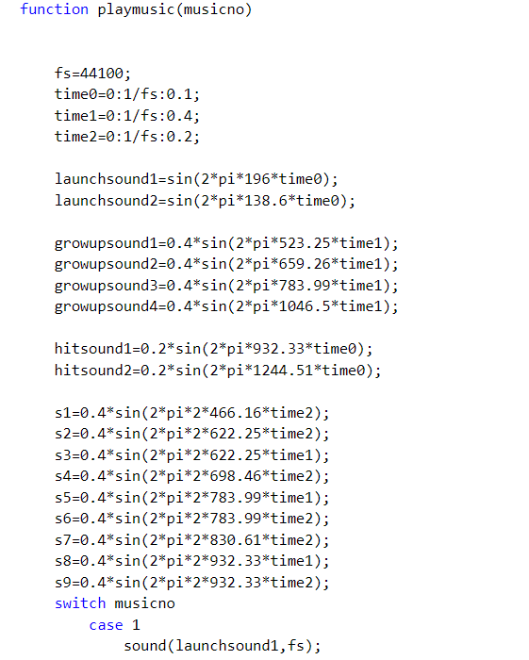
(4) Sound effect
This is a code to receive a variable (musicno) based on the situation in the game and to play music corresponding to the variable.

Slide 12
3. Video of playing the game
https://youtube.com/shorts/K97Xm4Uyopw

Slide 13
4. Original Code Source
Source code credit: Creating Snake Game - MATLAB Answers - MATLAB Central (mathworks.com)
The original game involves controlling a snake using arrow keys to eat food and grow in size. While the black plot screen from the original code and the 'keyfunction' function were used for a similar approach, the overall concept, gameplay, and the overall framework are entirely different in this game (80% original).

Slide 14
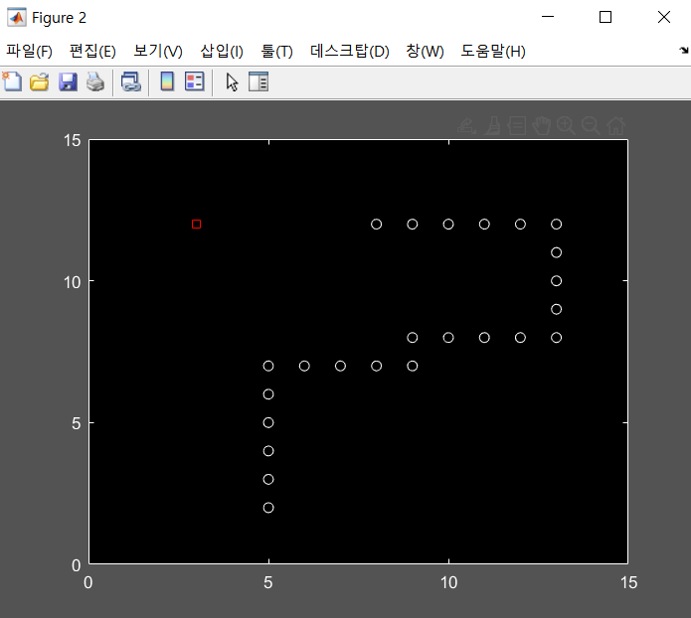
This is a screenshot of the original game

